Slide 1
February 16-19, 2018
www.BirdCount.org
Notes:
1
Welcome to this presentation about the 20th annual Great Backyard Bird Count—often called the “GBBC” for short! The next count is taking place February _____ through the ____. The GBBC is led by the Cornell Lab of Ornithology and the National Audubon Society with Canadian partner, Bird Studies Canada. The program website is BirdCount *dot* org.

Slide 2
The GBBC is global!
Notes:
2
Because the GBBC is part of the eBird online checklist program, anyone with an Internet connection, anywhere in the world, can take part, even through a mobile device. All ages and skill levels are very welcome – if you can identify a single species of bird we want to hear from you.

Slide 3
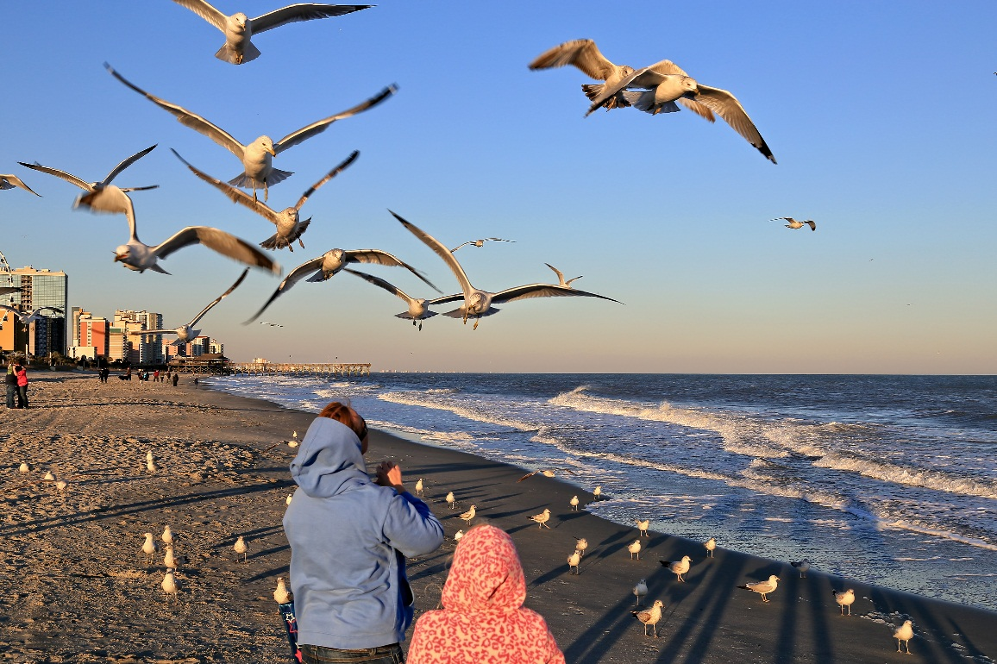
Count birds wherever you like
Backyards
Parks
Nature Centers
Anywhere!
Notes:
3
Though it’s called the Great BACKYARD Bird Count—you can count birds anywhere—at a nearby park, nature center, your schoolyard, or neighborhood—anywhere you find birds!

Slide 4
Participate from anywhere in the world
Access personal bird lists
Use account to report birds year round
Life lists and records
Notes:
4
In addition to accepting bird observations from anywhere in the world, you can now use the eBird and GBBC programs to keep track of your bird life list, yard list, and any other lists for countries, states, provinces, and counties which will be automatically stored and updated. You can explore what is being reported by others in your area and around the world—and you can keep on reporting your birds year round through eBird. You can always go back into your reports anytime to edit or make corrections, either through the GBBC website or directly in eBird.

Slide 5
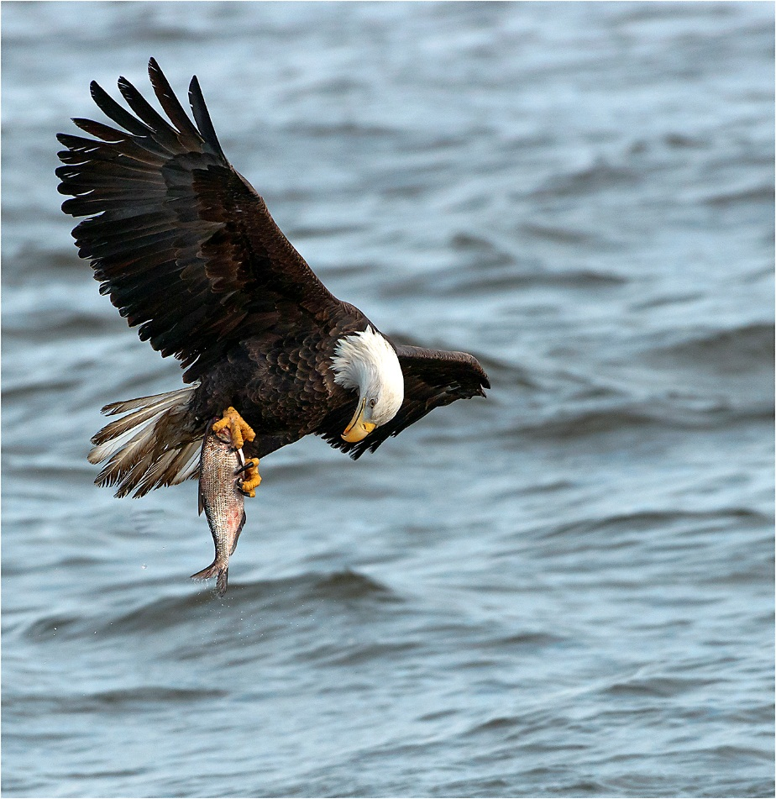
Why participate?
Scientists can’t be everywhere
Long-term record of birds Make sure your birds are counted
Notes:
5
Your observations are important because no single scientist or team of scientists could hope to capture so much information about birds around the world in only four days. Each year tens of thousands of people submit checklists reporting many millions of birds. Your information provides a long-term record of how bird populations may be changing over time. Make sure your birds are represented by counting them for the GBBC!

Slide 6
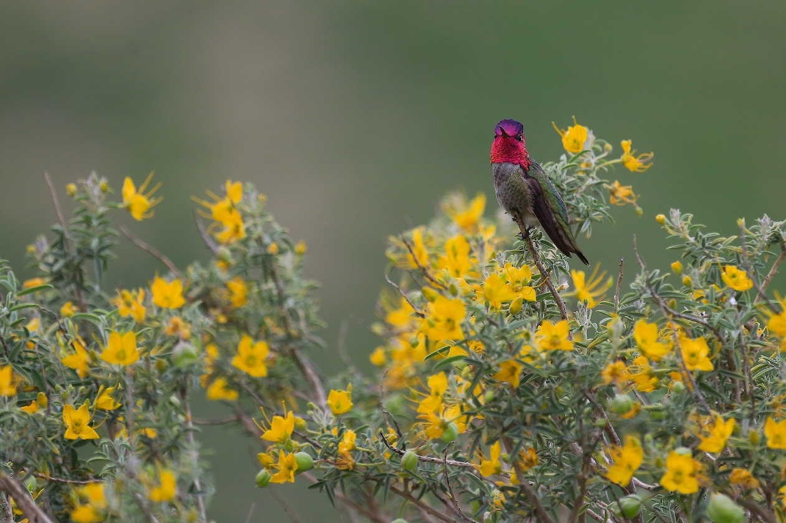
What do we learn?
Migration patterns
Year-to-year changes
Long-term trends
Notes:
6
Every sighting reported in the Great Backyard Bird Count becomes part of a permanent record that anyone with Internet access can explore. You can use the information to track migration patterns and year-to-year changes in the abundance and distribution of birds and learn about the complex patterns of bird movements. Look for trends that indicate how well birds are faring in the face of environmental changes such as urbanization, global climate change, and disease.

Slide 7
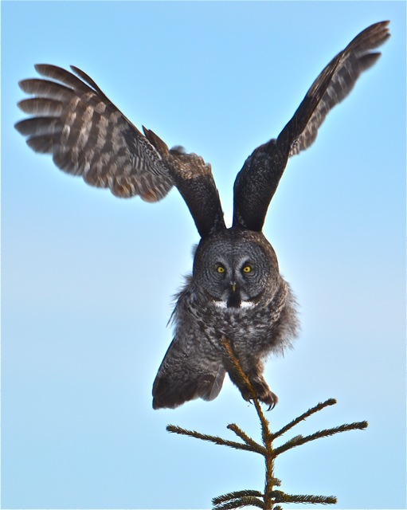
What do you do?
Count birds anywhere for at least 15 minutes
Count longer if you wish!
Keep track of time
Best estimate of number of individuals of each species
Notes:
7
Now let’s walk through the steps for participating. It’s very important that we all count our birds the same way so the information is consistent. You can count at any location for at LEAST 15 minutes, but you’re welcome to watch much longer than that. Keep track of the total amount of time you spend watching and roughly how far you walked if you’re hiking. Please make your best estimate of the number of individuals of each species you saw. For instance, if you’re watching at a feeder and see three chickadees, then four chickadees, then one chickadee, you would report them as four chickadees, not eight.

Slide 8
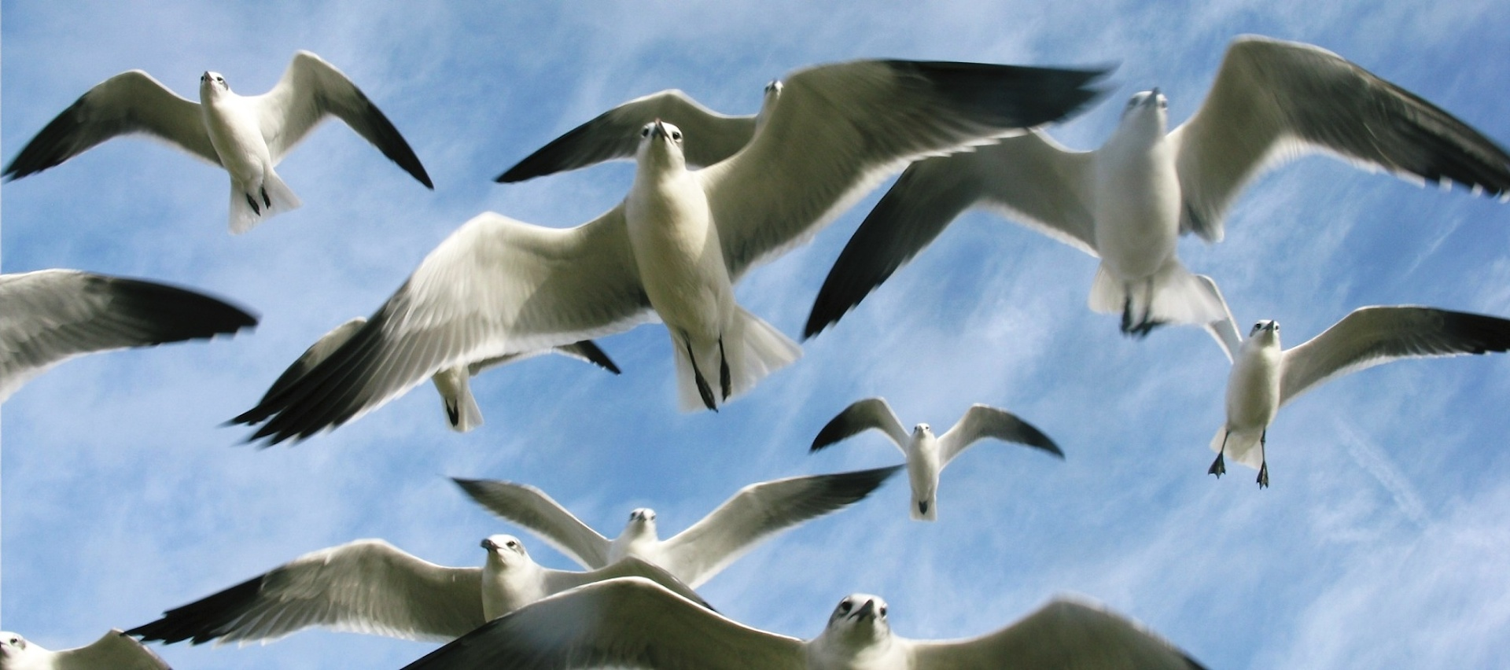
New checklist for each day
New checklist for each new location
New checklist for same place, new time
Notes:
8
Create a separate bird checklist for each day you participate. Submit a separate checklist for each new location, even if it’s on the same day. You can submit multiple checklists on the same day from the same location if the two counts were at different times—early morning and late afternoon, for example.

Slide 9
Entering counts: BirdCount.org
Notes:
9
When you’re ready to report your results, go to the Great Backyard Bird Count website at BirdCount *dot* org and click on the “Submit observations” tab on the home page.

Slide 10
Important!
Create a GBBC account if you are new or have not participated in the past two years
If you already use eBird, FeederWatch, or NestWatch, enter that username and password
Notes:
10
If you are new to the count or have not taken part since before 2013, you’ll first be asked to create a free GBBC account. If you already have an account for the GBBC, eBird, or another Cornell Lab citizen science project, please use that same username name and password to log in; you do NOT have to create a new account.

Slide 11
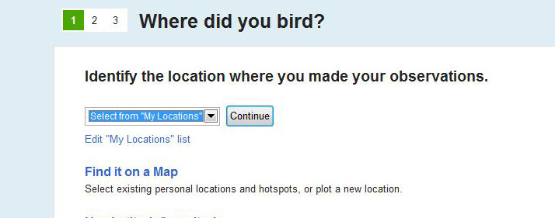
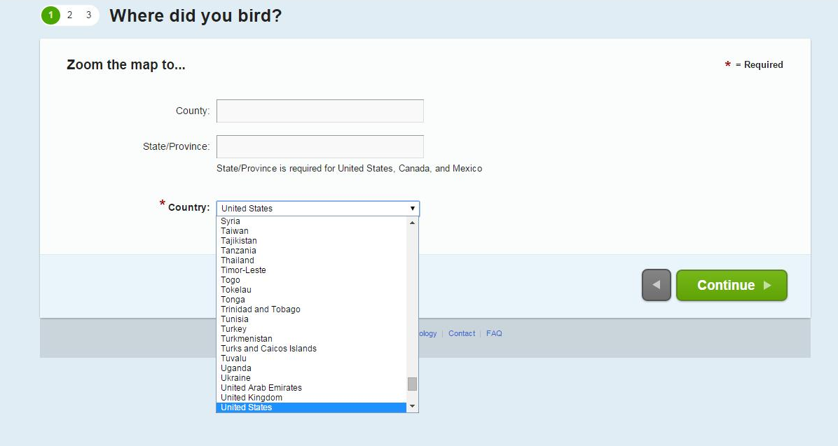
Notes:
11
When you’re ready to enter your checklists you’ll first be asked “Where did you bird?” This is where you map the exact location where you were counting. If you’ve done the count before you can choose a site you’ve already mapped. If you’re watching at a new location or participating for the first time, click “Find it on a Map” on this page. On the next screen, shown here on the lower-right, you’ll fill out your county, state, or province—and choose your country from a drop-down menu. Participants in the U.S., Canada, and Mexico must enter their state or province

Slide 12
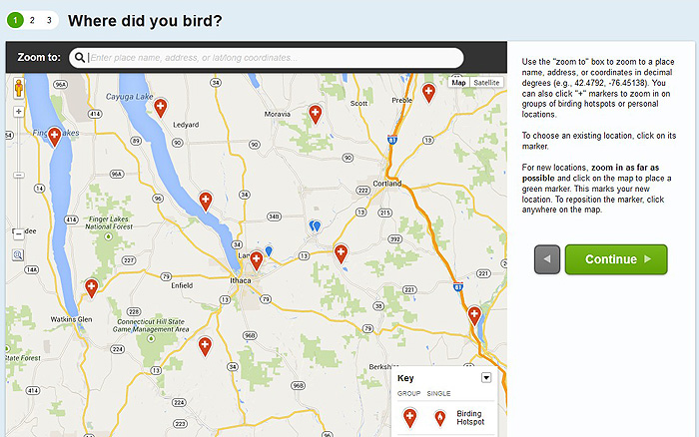
Notes:
12
When the map comes up, zoom to your location or type the address in the top search bar. When you have found the location you want, left-click on it with your mouse. You’ll see a large green marker which you’ll drop at your birding location—then it turns blue. Position the marker, if needed, and name your location so you can choose it again for future checklists. The red markers you see are birding “hotspots” set up by other birdwatchers and you can use them as your location if you were counting birds there.

Slide 13
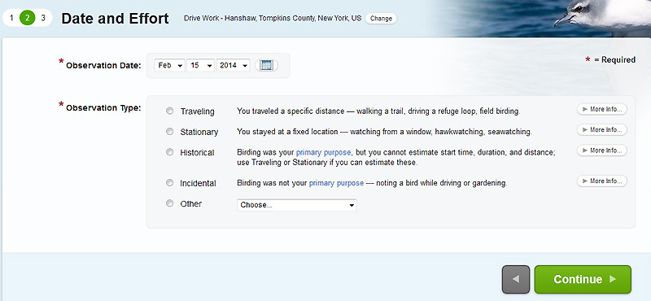
Notes:
13
Next step: The Date and Effort page. This where you tell us which date the checklist is for and the type of count you did. Choose: traveling if you were walking or driving around (if you’re driving, please break down the route into segments with the same habitat, preferably five miles in length or less and submit a separate checklist for each segment); choose stationary if you stayed in one place, perhaps watching feeders from a window; choose incidental if you’re reporting birds you saw while you were doing something else and watching birds was not your primary activity.

Slide 14
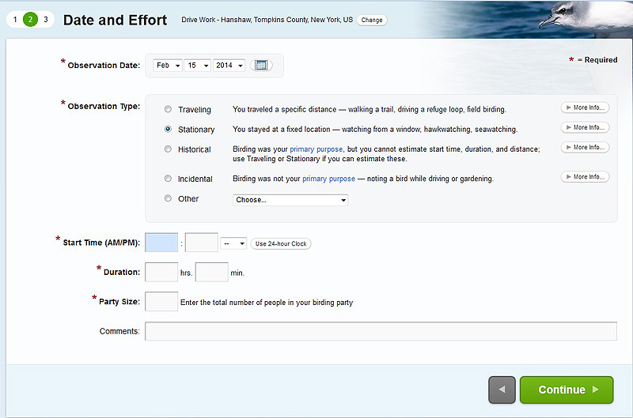
Notes:
14
After you choose the type of count you did, you’ll see additional spaces show up below where you mark the time you started, how much total time you spent counting, how many people contributed to the checklist, and the distance covered if it was a traveling count. When putting in your birding start time, put hours in the first box and minutes in the second. Remember to choose “A.M.” or “P.M.” from the small dropdown menu.

Slide 15
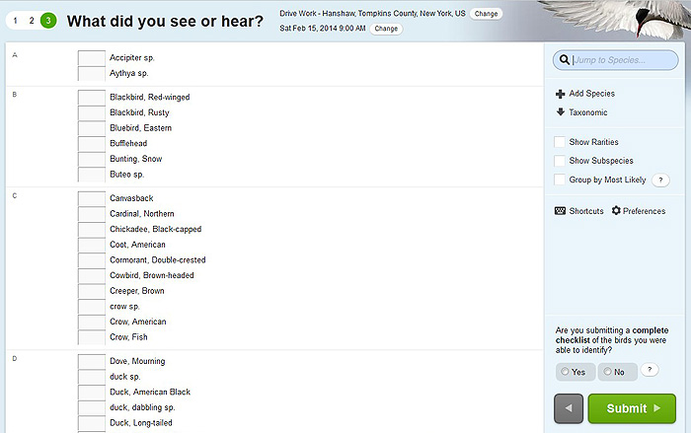
Notes:
15
Now you’re on the bird list page, showing the species that are likely to be seen in your area in February. There are several tools and options in the light-blue column on the right side of the bird list page. You can look for a species in the list using the “jump to species” search bar at the top. You may change the list from taxonomic to alphabetical order and show or hide rare species and subspecies. If a bird you saw does not appear on the main checklist, click the "show rarities" option. If the species still isn’t there, go to “Add Species,” type the name, and add it to your list. If you’re participating from a country outside the U.S. and Canada, click “preferences” to set your preferred language for bird names; you can also search for a species by its scientific or Latin name.

Slide 16
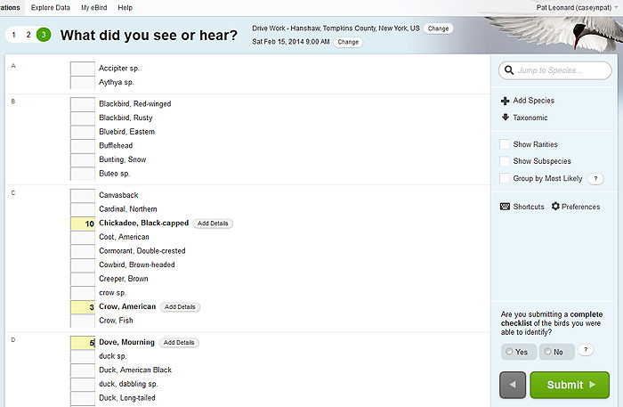
Notes:
16
As soon as you enter a number next to a species, you’ll see a small “Add Details” button appear to the right of the bird name. Clicking it provides additional space for you to add information about the sighting if you wish. This is especially important if you are reporting something rare or in unusually high numbers. Use this section to add notes on how you identified the bird and even upload a digital image with your checklist. A photo is very helpful in confirming a rare sighting. Photos uploaded with checklists become part of the Cornell Lab’s Macaulay Library digital archive.

Slide 17
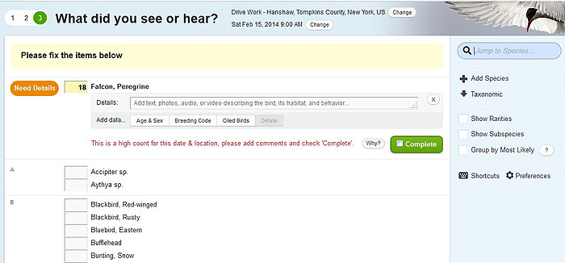
Notes:
17
If you enter a species or a number of birds that is unusual, you will get a message in a yellow bar at the top of the page asking you to fix the item. If you’re sure about the sighting and have added comments supporting it, click the green “complete” button. Your report will go to a GBBC data reviewer for your area. This is a normal part of the process. You may even be contacted by a reviewer to confirm the sighting. This is just one of the ways that we make sure the data is accurate.

Slide 18
Notes:
18
In the lower right-hand corner of the bird list page, you are required to check whether you are submitting a complete checklist of all the birds you were able to identify. The only time you’ll select “no” is if you are deliberately excluding some species from your list (like if you counted everything other than crows or gulls or another species). Otherwise, click “yes” to indicate you are including everything you could identify---click “yes” even if you saw some birds you could not identify. Then click the green “submit” button.

Slide 19
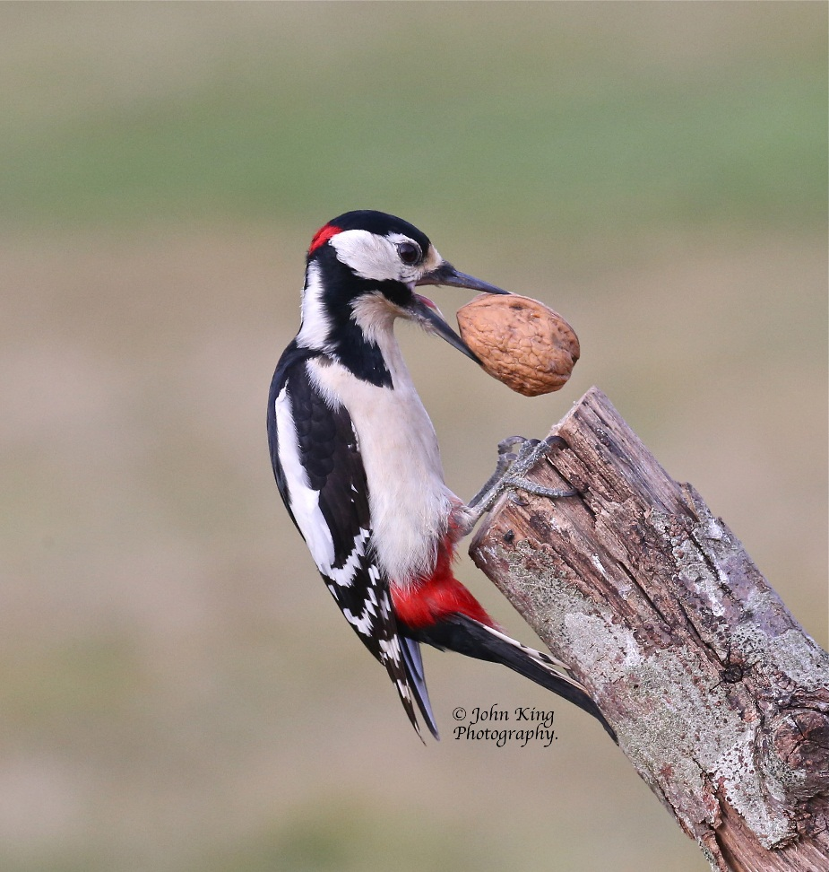
Review & edit
Email yourself a copy
Share with others who compiled the list
Submit another list
Notes:
19
You’ll see a confirmation page where you can review the list you submitted. If something isn’t right, use the small edit buttons to the right of each entry to edit your checklist. If you want a copy of your report sent to you, click “Email Yourself” at the top-right. If you were birding with a friend and want them to be able to add the list to their GBBC or eBird account, click “Share with Others in Your Party.” The checklists that you share this way will be included in your friends’ personal observations. Birds shared on your lists at the same location will not be counted more than once. If you just want to share your list with someone who was not birding with you, copy the web address at the top of your checklist and email that—you’ll see an ID number in the address. If you have other checklists to enter you can do so from the confirmation page using the links on the right.

Slide 20
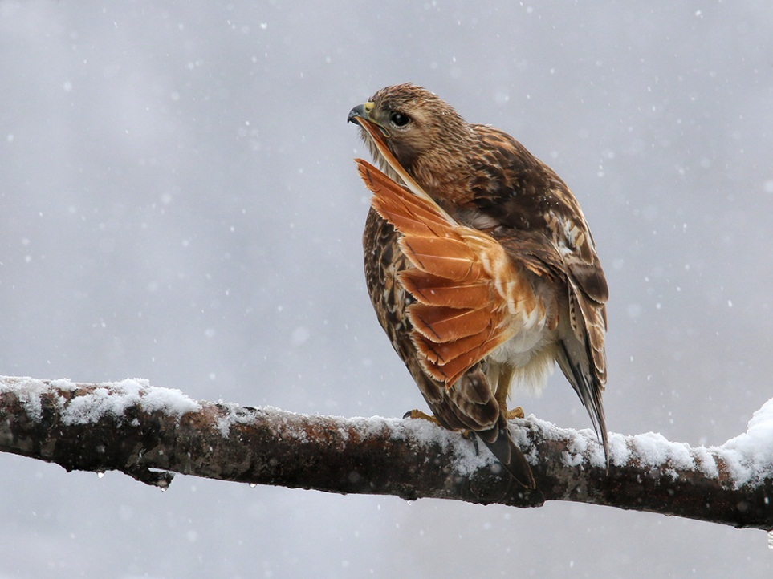
Join us for the Great Backyard Bird Count
www.BirdCount.org
Notes:
20
If you have other questions about the GBBC or how to create an account and enter or explore data, please read through our FAQs on BirdCount *dot* org. Your question may be addressed there. We hope you’ll join us for the next world-wide Great Backyard Bird Count. Tell others and invite someone new to try birding with you this year. You’ll find birding tips, gorgeous photos, and more at BirdCount *dot* org.

Slide 21
All photos by GBBC participants
Sybil Collins, mom and child
Paula Brown, gulls on the beach
Andrew Byerly, Bald Eagle
Michael Renzi, Anna’s Hummingbird
Anil Sarasavan, Egyptian Vulture
Sandy Venneman, Laughing Gulls
John King, Great Spotted Woodpecker
Peter Ferguson, Red-tailed Hawk
Notes:
21
All the photos you’ve seen in this presentation were taken by GBBC participants. You can upload your photos for the upcoming contest through the GBBC website. The top winner in each category receives great prizes.

Slide 22
Notes:
22
Extra slide for any local GBBC event.

